Slide 1
Git and GitHub operations
Aswin p p

Slide 2
Git
Git is a version control system that lets you manage and keep track of your source code history.
First developed back in 2005, Git is an extremely popular version control system that is at the heart of a wide variety of high-profile projects.
Git is installed and maintained on your local system (rather than in the cloud) and gives you a self-contained record of your ongoing programming versions.

Slide 3
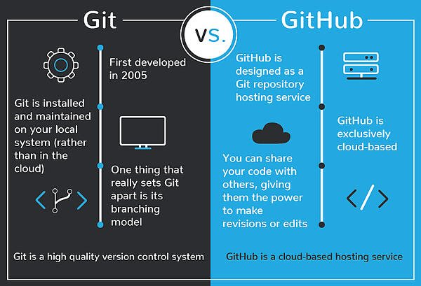
GitHub
GitHub is a cloud-based hosting service that lets you manage Git repositories.
If you have open-source projects that use Git, then GitHub is designed to help you better manage them.

Slide 4
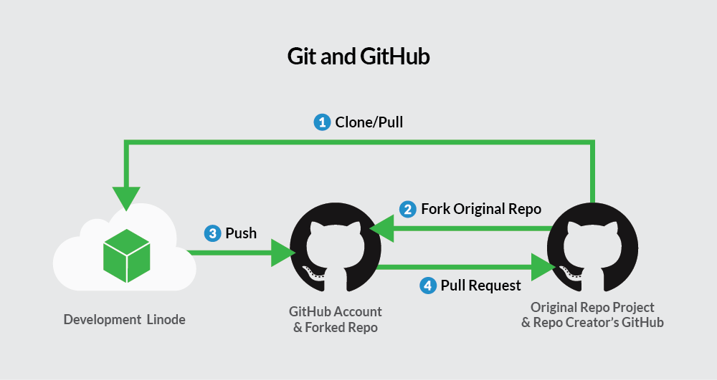
Github workflow

Slide 5
Steps for pushing a file to GitHub
Step 1: Install git and create a GitHub account
Step 2: Create a new repository on GitHub
Step 3: Open the path in command prompt
Step 4: git init (check in the folder where new file .git will be created automatically)
Step 5: git add . (to add all the files in the current directory)
Step 6: git commit –m “Initial commit”
Step 7: git status (to get status of tracked and untracked files)
Step 8: git remote add origin https://github.com/aswinpp24/UST_Training
Step 9: git push origin master

Slide 6
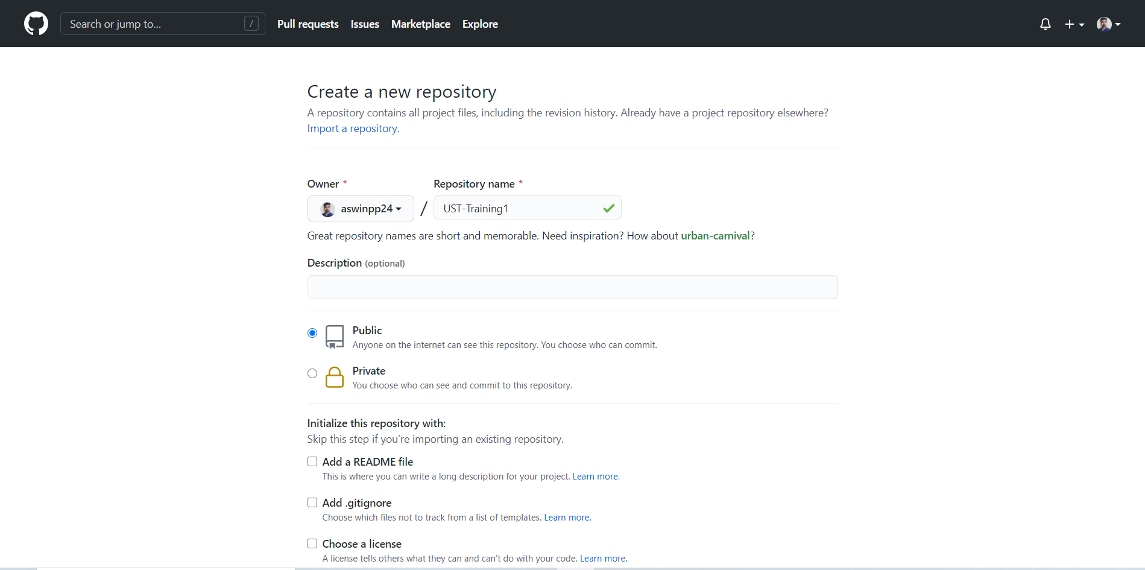
Create a repository on github

Slide 7
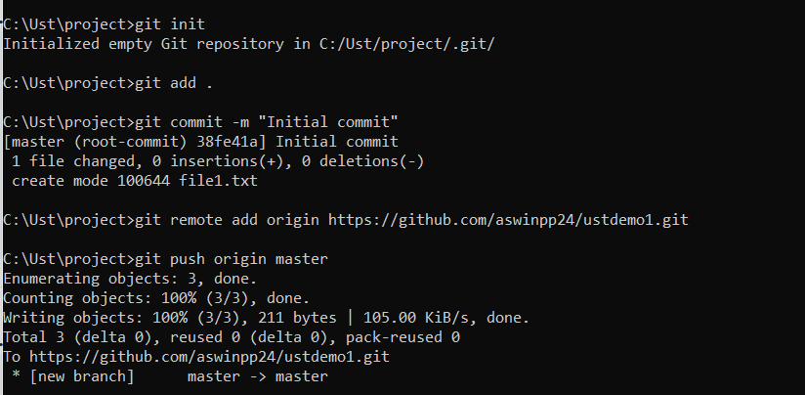
Github workflow

